Slide 1
AUTONOMOUS VALET PARKING
Group number-19
Pavan Prasad HG - 5508053
Marnix Enting - 4659147
Tishar Sinha - 5277876
Abhishek Kumar Kejriwal - 5217555

Slide 2
Model and Planning
Problem description and Proposed Solution:
Inefficiency in finding a parking slot in large parking spaces (such as airport, malls etc.)
Car navigating to the nearest parking slot autonomously
Environment : Parking Garage with Perpendicular Parking
Occupancy grid map of size (1000 x 1000).
Workspace: R²
Configuration Space: R² x S¹
Selected Path Planners:
RRT*
A*
Bi-directional A*
Controller: Car Kinematic model (Bicycle Model) with MPC

Slide 3
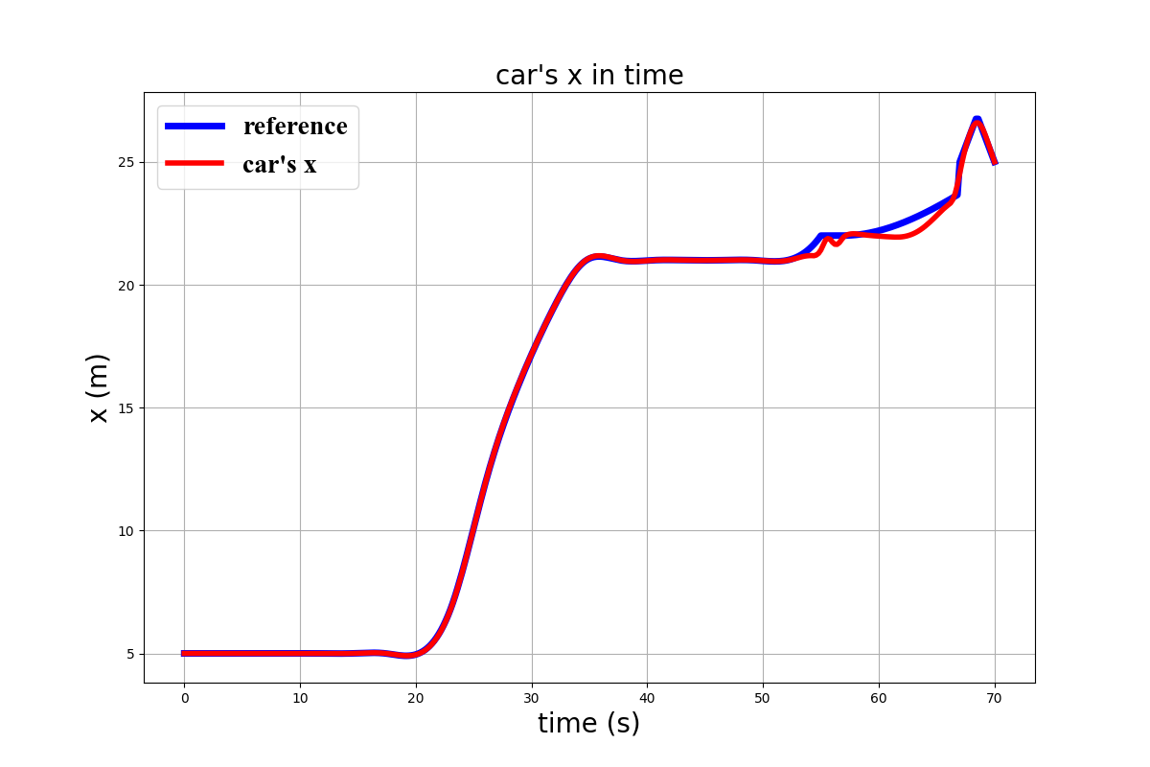
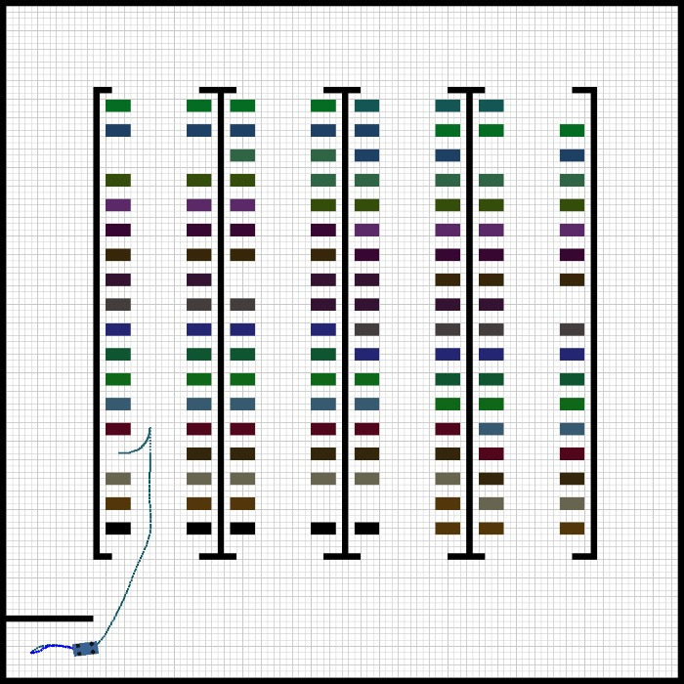
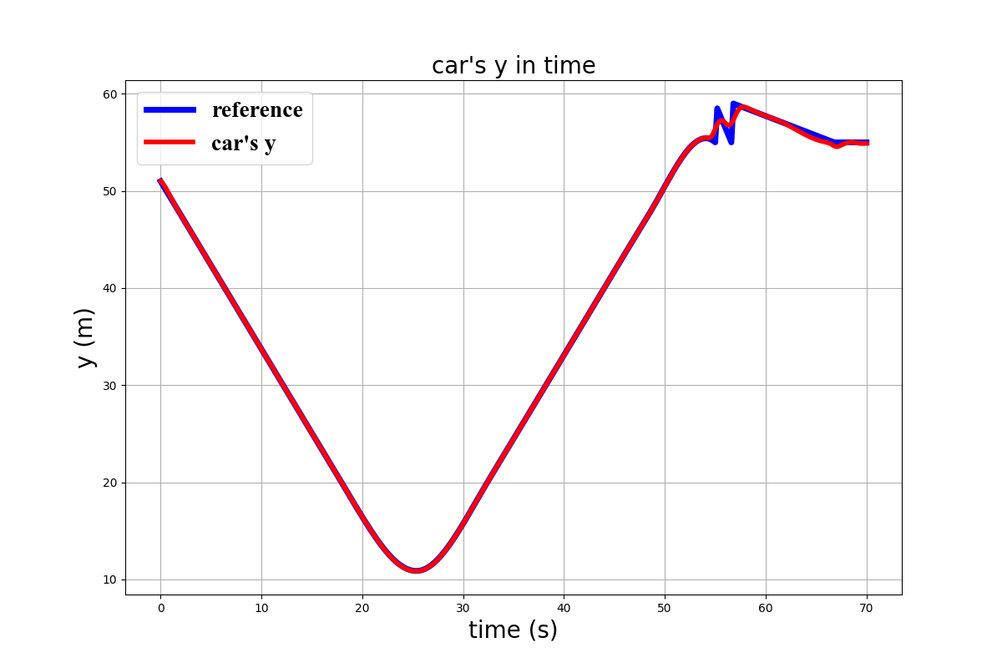
Results

Slide 4
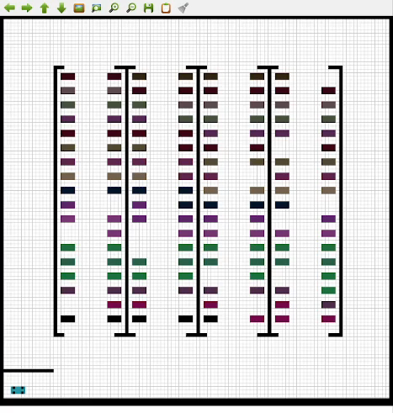
Results - Video

Slide 5
Discussion
Conclusion:
Of all the selected path planners, Bi-Directional A* works the fastest for this application.
RRT* proves to be slower when the obstacle space is large.
Fairly Robust and smooth.
Improvements and Future work:
Parking maneuver can be smoother.
Directionality of the car can be added.
Simultaneous implementation for multiple cars.
Inclusion of dynamic obstacles

